Slide 1
LEACH: An Application-Specific Protocol Architecture for Wireless Microsensor Networks
Wendi Heinzelman Anantha Chandrakasan Hari Balakrishnan
Massachusetts Institute of Technology

Slide 2

Sensor Networks
f(A-G)
B
C
D
A
F
E
G
Base station
Remote monitoring of the environment
Surveillance
Machine diagnostics
Relevant parameters:
System lifetime (energy efficiency)
Quality
Latency

Slide 3
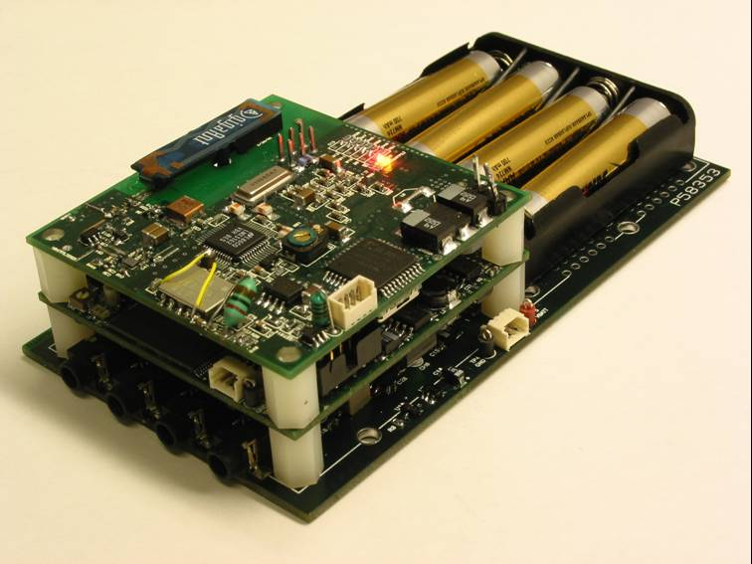
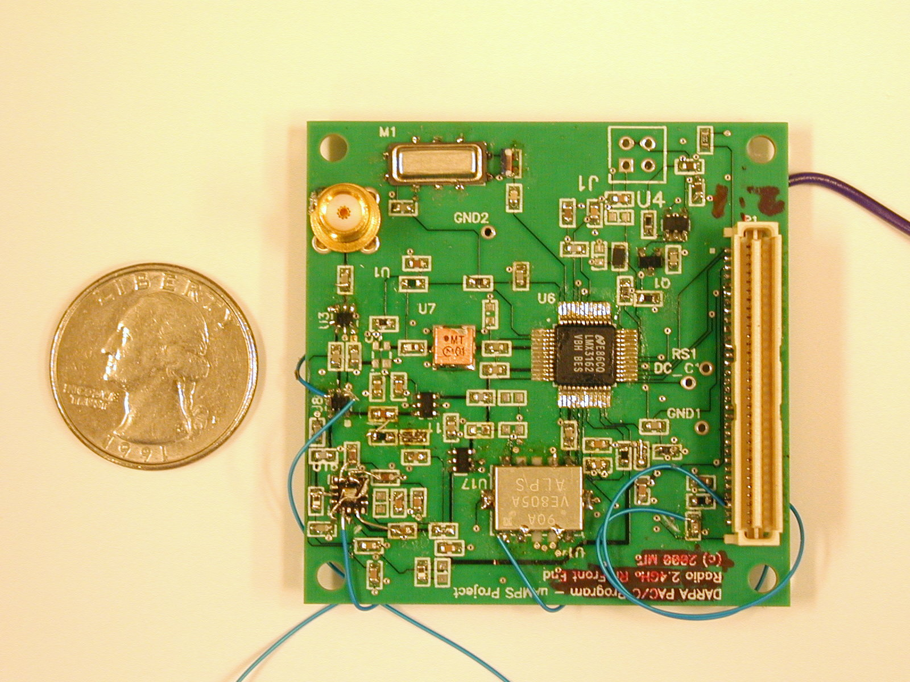
Context: MIT μ-AMPS Project (1999)
Energy-optimized sensors
Node architecture and radio hardware
OS, algorithms, and protocols
Assumptions:
Base station far from nodes
All nodes energy-constrained
Locally, data correlated
Communication protocols important
Node
RF module

Slide 4
Prior Work
Direct transmission
Energy scales as R^{n}
Routing
E.g., Min transmission Energy
Multi-step communication
Short lifetimes for close nodes
Clustering
Cellular model
Needs high-energy cluster-head
R
A
B
C
ABC if:
d_{AB}²+d_{BC}²<d_{AC}²

Slide 5
LEACH
Cluster-head
Base station
Low-Energy Adaptive Clustering Hierarchy
Adaptive, self-configuring cluster formation
Localized control for data transfers
Low-energy medium access
Application-specific data aggregation

Slide 6
LEACH Operation
Set-up
Steady-state
Frame
Round
•••
START
START
START
Time
Randomized cluster formation
Each node decides to become cluster-head with some probability
Picked so the expected number of cluster-heads is k
k is a system parameter (and there’s a way to pick a good k)
Rotate cluster-heads each round
Clusters formed during set-up
Data transfers during steady-state
Requires nodes to be synchronized

Slide 7
Distributed Cluster Formation
• Assumes nodes begin with equal energy
• Each node CH once in N/k rounds
r +1 = current round of operation
k = system parameter
C_{i}(t) = 1 if node i a CH in last r rounds
Autonomous decisions lead to desirable emergent behavior

Slide 8
Unequal Initial Energies
E_{i}(t) = energy of node i at time t
E_{total}(t) = total energy in system at time t
High-energy nodes CH more often than low-energy nodes
If nodes begin with E_{o}
Cluster-head nodes
E_{i}(t) ≈ E_{o} – X
P_{i}(t) ≈ 0
Non-cluster-head nodes
E_{i}(t) ≈ E_{o}
P_{i}(t) ≈ k/(N-kr)
E_{total} ≈ E_{o}(N-kr) + (E_{o}-X)kr

Slide 9
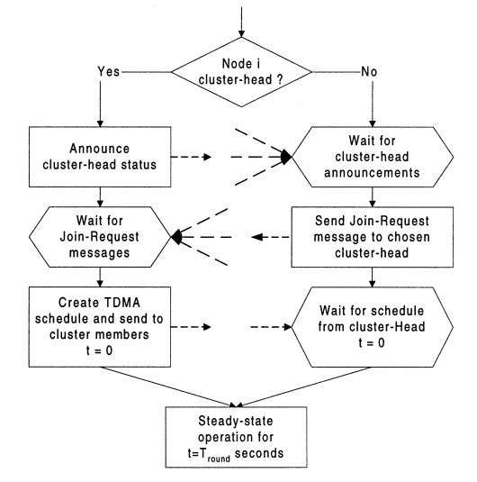
Distributed Cluster Formation Algorithm
• No global control
• Flexible, fault-tolerant
Using P_{i}(t)
Cluster-head
Nodes
Non-CH
Nodes
Choose CH with highest-SNR announcement

Slide 10
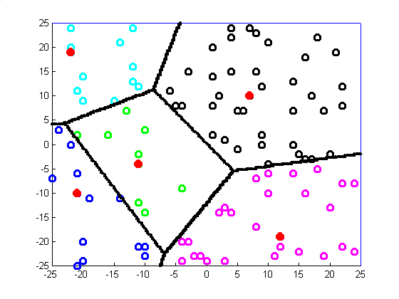
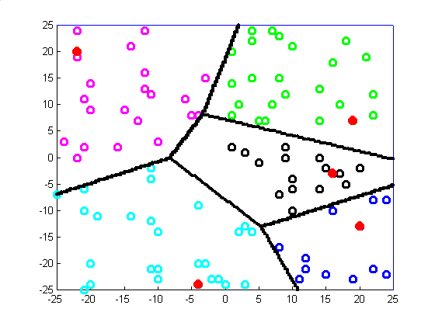
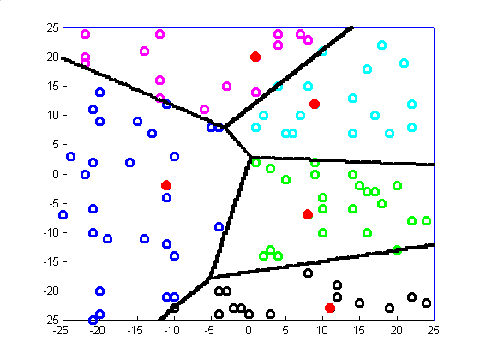
Dynamic Clusters
Adaptive clusters
Rotation to evenly distribute energy load
Clusters during different rounds in LEACH
Cluster-heads = •

Slide 11
LEACH Steady-State
Set-up
Steady-state
Slot for
node i
Slot for
node i
Clusters formed
•••
Time
Frame
Cluster-head coordinates transmissions
TDMA schedule
Node i transmits once per frame
Low-energy approach
No collisions
Maximize sleep time

Slide 12
Inter-Cluster Interference
B
A
C
Cluster B
Cluster C
Transmission in different clusters can collide
Nodes minimize transmission power
Each cluster has unique, orthogonal spreading code (e.g., CDMA codes)
Distributed solution to minimize interference

Slide 13
LEACH Medium Access
Set-up
Steady-state
ADV
Join-REQ
SCH
Time
CH
Non-CH
CH
ADV
• CSMA
• Large power, small messages
Join-REQ
• CSMA
• Large power, small messages
SCH
• CDMA code
• Power to reach all members
Data Transfer to CH
• TDMA (with CDMA code) – no collisions
• Power to reach CH, large messages

Slide 14
Application-Specific Data Aggregation
Data
Aggregation
.
.
.
Local sensor data often correlated
Data aggregation
Common signal enhanced/noise reduced
Improved detection and classification
Compute to reduce communication energy at cluster-head

Slide 15
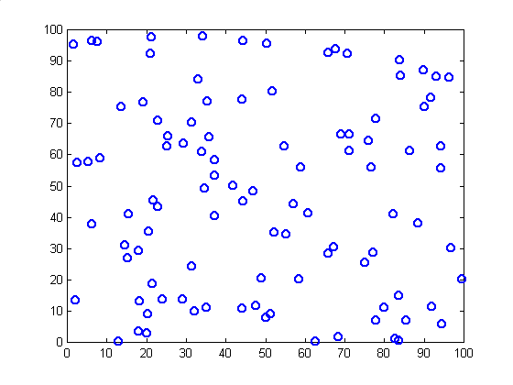
Simulation Parameters
Base Station
Nodes | 100
Network size | 100 m x 100 m
Base station location | (50,175)
Radio prop. speed | 3x10⁸ m/s
Processing delay | 50 μs
Radio speed | 100 kbps
Radio electronics | 50 nJ/bit
Transmit amplifier | 100 pJ/bit/m²
Beamforming cost | 5 nJ/bit/signal
Data size | 500 bytes
75 meters
100 meters
100 meters

Slide 16
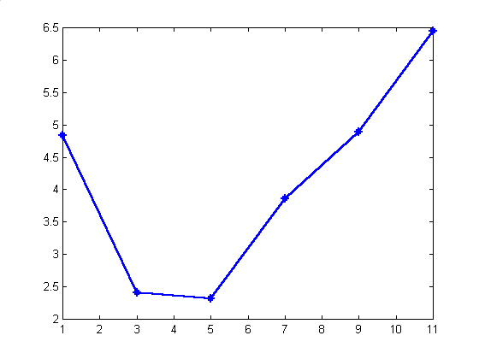
Optimum Number of Clusters, k
N=100
M=100
75 < d_{toBS} < 185
Analytic
Result:
 2 < k < 6
k=11
k=1
k=9
Simulation
Result:
Average energy per round (J)
k=7
k=3
k=5
Number of clusters (k)

Slide 17
Centralized Cluster Formation (LEACH-C)
• Attempts to compute optimal clusters for comparison
• Needs GPS or other location-tracking method
All Nodes
Base Station
• Small packets
• Large energy
• Only nodes with E_{i} > μ_{E} eligible
• Simulated annealing

Slide 18
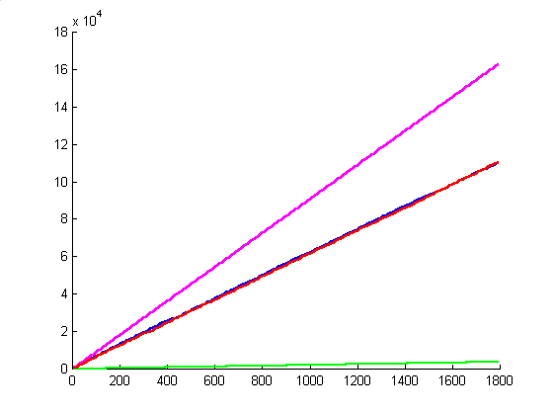
Simulations: Data Over Time (Assuming no energy constraints)
Static-
Clustering
Amount of data received at BS
LEACH
LEACH-C
MTE
Time (s)
Static clustering: no set-up time
LEACH data – 2 hops
MTE data – 10 hops on average

Slide 19
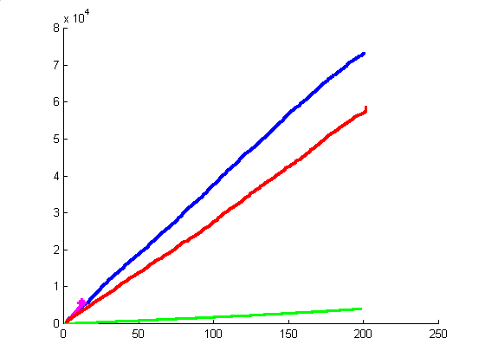
Simulations: Data per Energy
LEACH-C
Static-
Clustering
Amount of data received at BS
LEACH
MTE
Energy Dissipation (J)
LEACH achieves order of magnitude more messages per Joule
Data aggregation successful

Slide 20
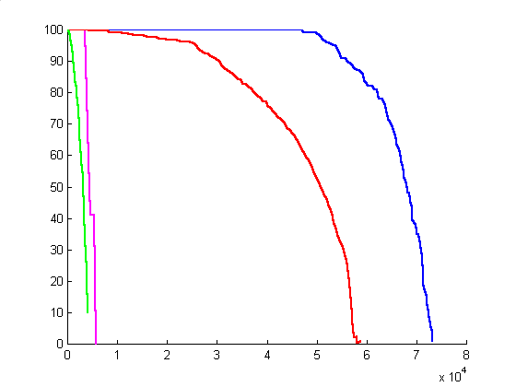
Network Lifetime with Limited Energy
Static-
Clustering
LEACH-C
Number of nodes alive
LEACH
MTE
Amount of data received at BS
LEACH delivers over 10 times amount of data over system lifetime
Rotating cluster-heads is effective

